Slide 1
OOP and Java Language Features
Pragati Software Pvt Ltd

Slide 2
Topics for today’s session
Object Oriented Programming Concept
Abstraction
Encapsulation
Inheritance
Polymorphism

Slide 3
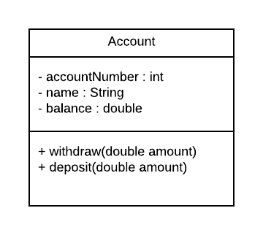
Object Oriented Programming Concept
Object –Oriented Programming is a methodology to design a program using Class and Objects
Class
Is a blueprint or a set of variables and
Methods to build a specific type of object.
Objects
is an instance of a class.
accountNumber = 101
name= “Vivek”
balance= 1000
Account One
accountNumber = 102
name= “Trupti”
balance= 3000
Account Two
accountNumber = 103
name= “Raj”
balance= 1000
Account Three

Slide 4
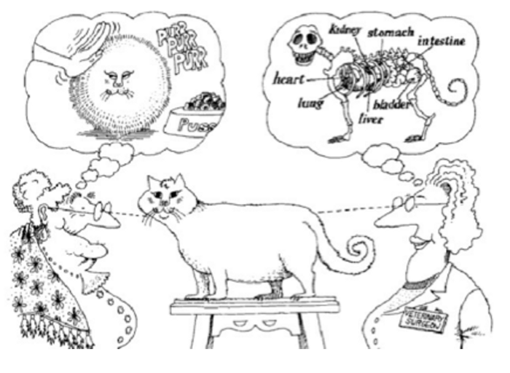
Abstraction
Abstraction is where you focus on only those details that are important for your purpose.
Abstraction is the process of refining away all the unneeded/unimportant attributes of an object and keep only the characteristics best suitable for your domain

Slide 5
Encapsulation
Encapsulation is a mechanism of wrapping the data (instance variables) and code acting on the data (methods) together as a single unit like a Class.
Encapsulation leads to data hiding.

Slide 6
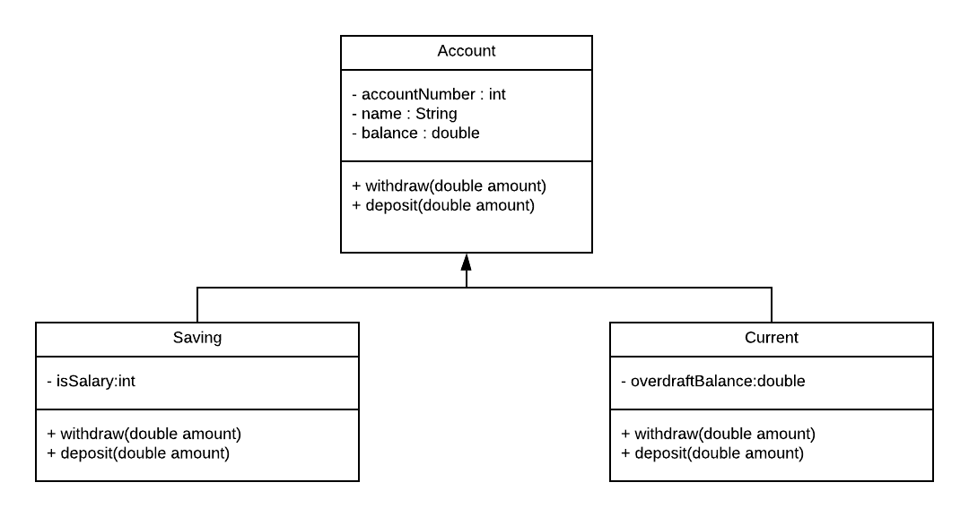
Inheritance
Inheritance can be defined as the process where one class acquires the properties (methods and fields) of another.
Inheritance provides extensibility.
If two classes follows “is a” relationship it is an inheritance
Generalized Class
Spacialized Class

Slide 7
Polymorphism
The characteristic of being able to assign a different meaning or usage to something in different contexts — specifically, to allow an entity such as a function, or an object to have more than one form.
Polymorphism is not possible without Inheritance.

Slide 8
More on Classes and Object
Data
Code
public static void main(String args[])
{
Account account;
account = new Account();
account.setAccountNumber(101);
account.setName(“Vivek”);
account.setBalance(2000);
}
accountNumber = 101
name = Vivek
Balance = 2000
Heap
Stack
account

